Slide 1
How we are going to use this technology
Using configured testing to adoubt different environement configuration

Slide 2
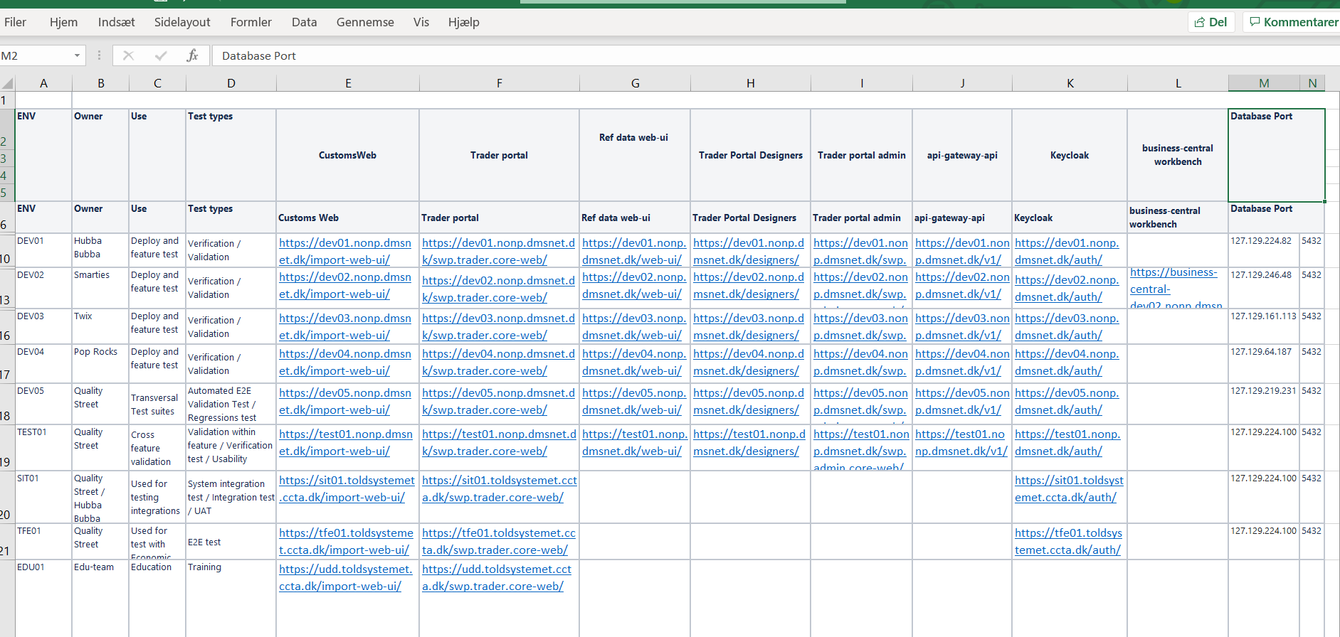

Slide 3
Reflecting The Test enviroements in different configuration files for eks:
TEST01->TES01Enviroment.cfg
SIT01 -> SIT01Enviroment.cfg
TFE01->TFE01Enviroment.cfg
.
.

Slide 4
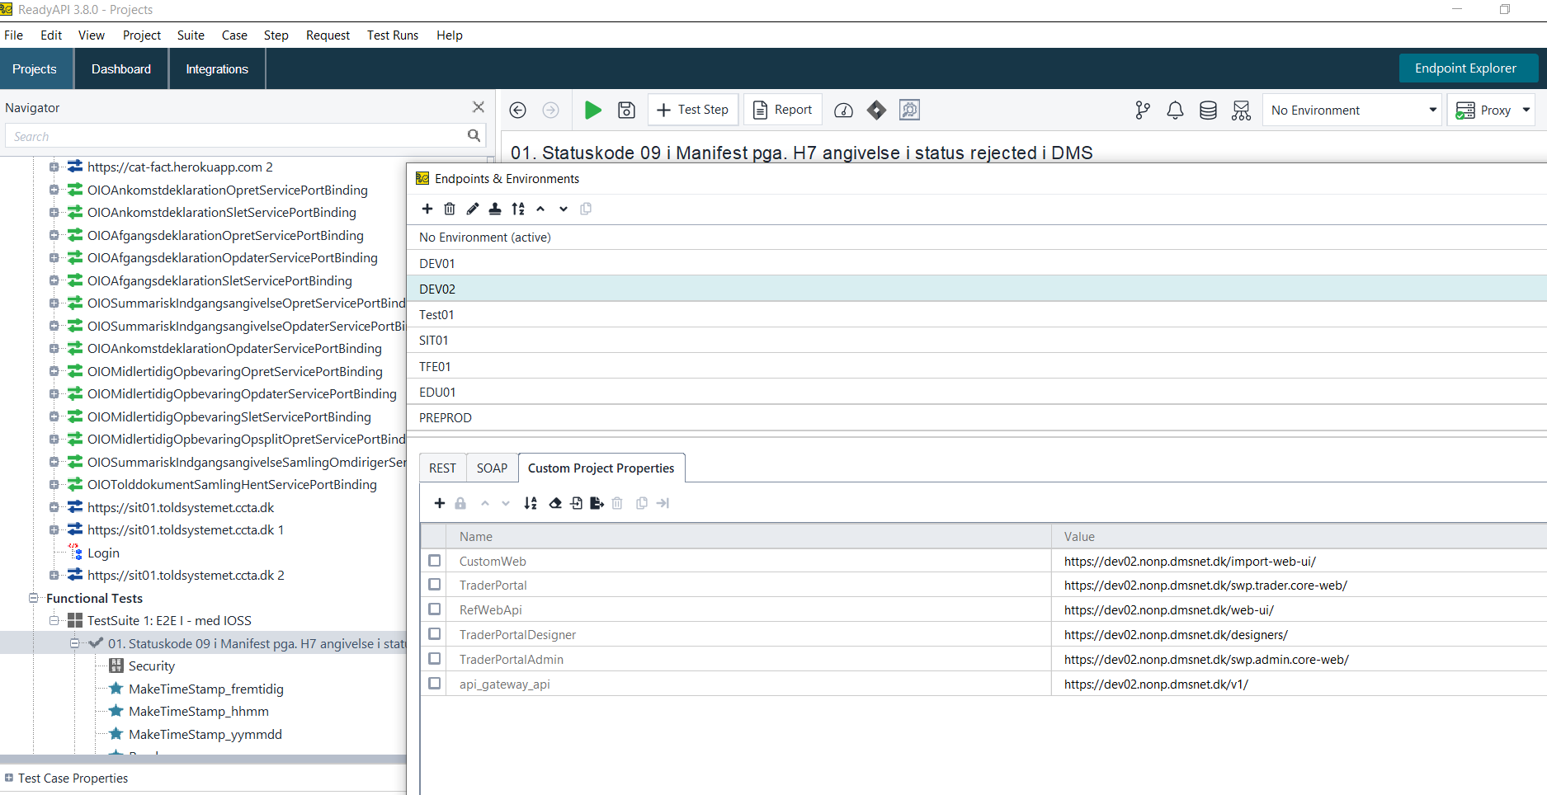

Slide 5
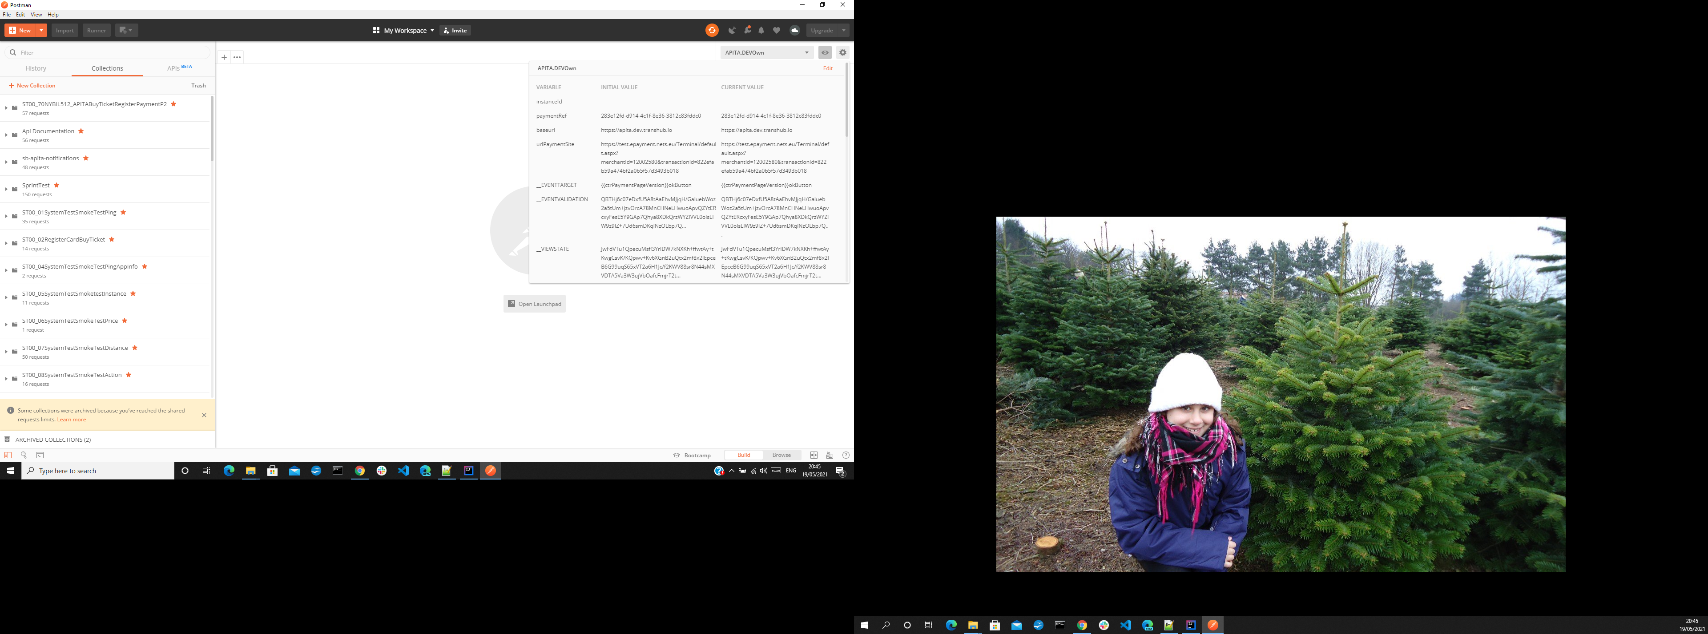
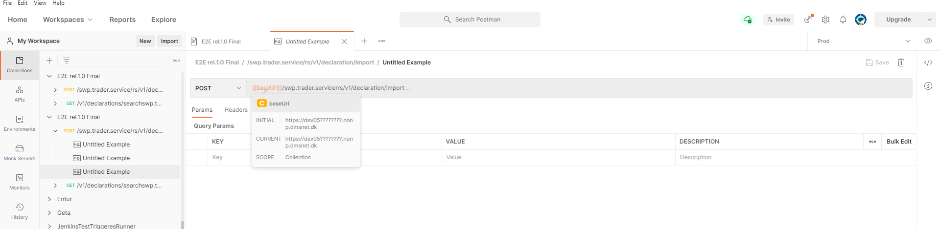

Slide 6
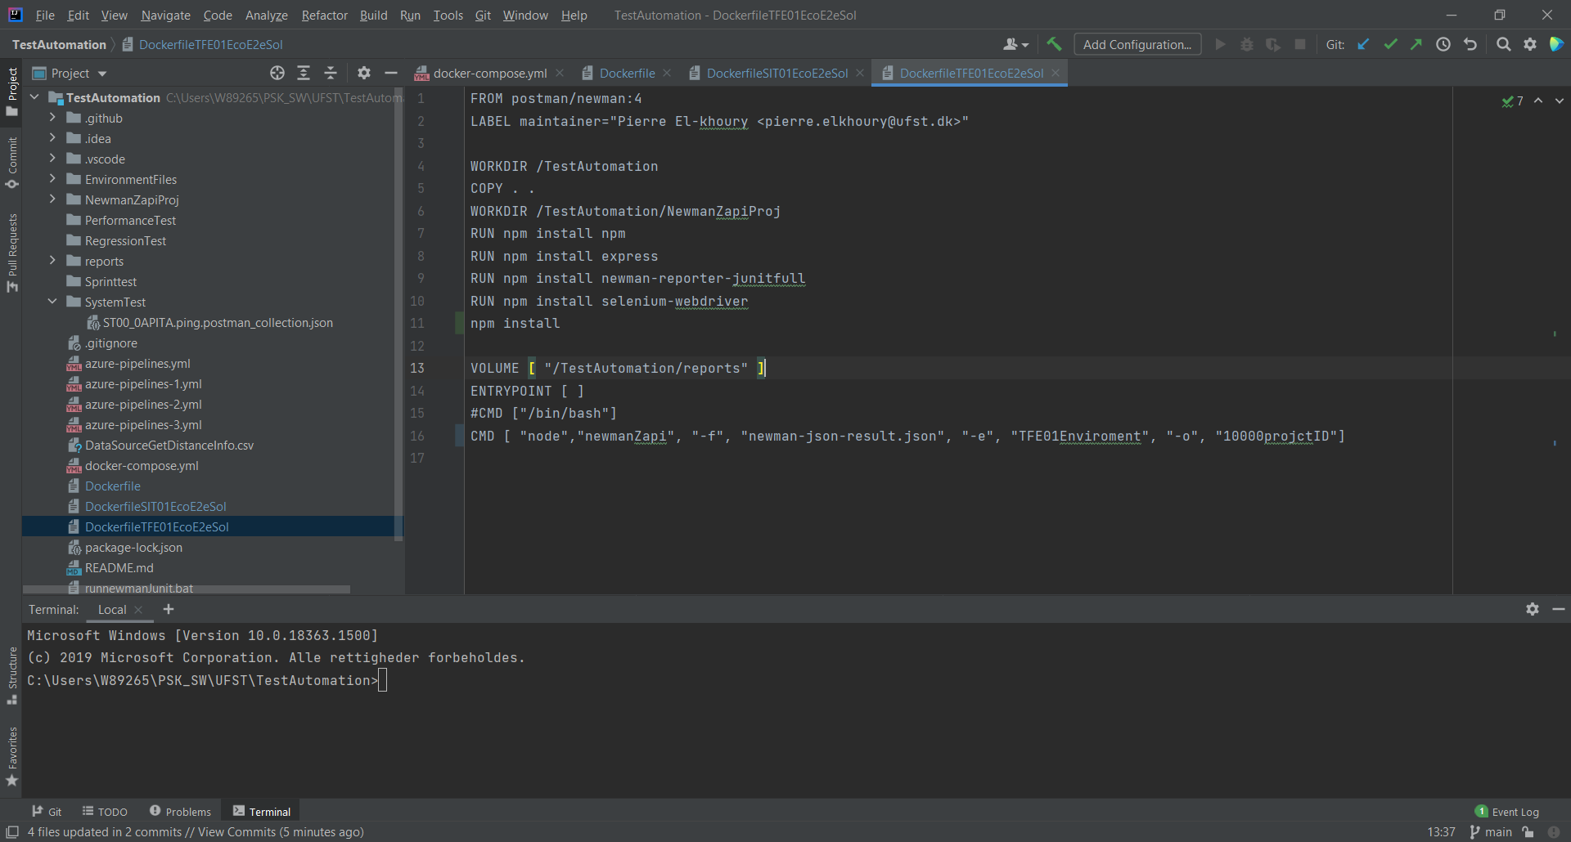

Slide 7
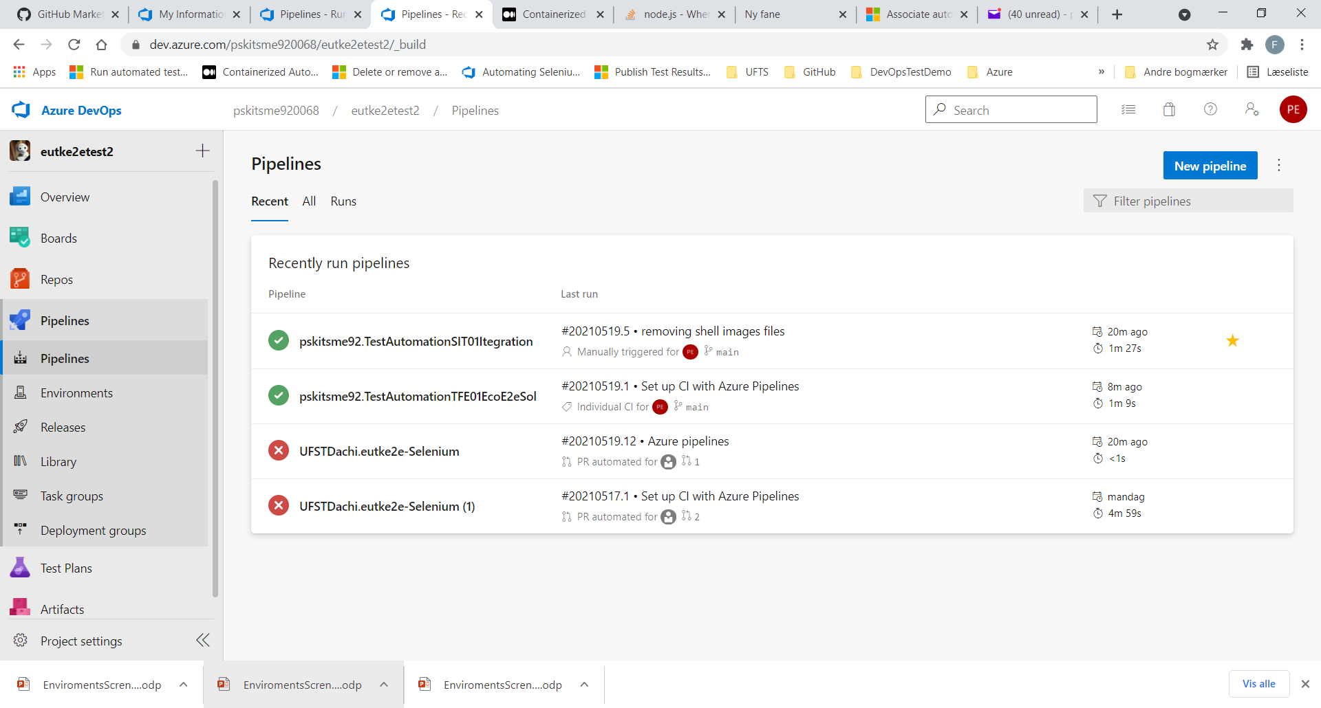

Slide 8
